Slide 1
Search Online Advertising Marketplace Auction Process

Slide 2
Session Overview
General Terminology in Search Online Advertising Marketplace Auction Process
Auction Process
Ad Scoring
Filtration
Rank Score and De-Duping
Ad Placement and Layout
Pricing and Rendering
Generalized Second Pricing Model

Slide 3
General Terminology
Search Query
Speller:
Misspelled queries are corrected and ads are rendered based on the correctly spelled keyword / query
Normalization:
Process of removing stop words and characters from the search query before the auction process in order to simplify the query
Stop words are common English function words exclusive of nouns, adjectives and verbs
Most common stop words are: about, an, and, at, by, for, from, how, in, is, of, on, or, the, to, what, with - as well as several punctuation/special characters
Once keywords go through above processes, the resulting keyword(s) are called “Normalized Keyword”
As of June 2015, to improve keyword matching, Bing Ads has made changes to the normalization process which no longer removes accents, apostrophe’s at the end of the words and stop words (mentioned above) from keywords and user queries
Entity Identity List:
List of normalized keyword created from the search query to map with the inventory of keywords (listings) bidded upon by advertisers
Speller
Normalization
Entity Identity List
Ad Selection By Match Type
Exact
Phrase
Broad
Smart/MSM
Ad Inventory
KWs
Ad Copy
Landing Page
Negative KWs
Targeting

Slide 4
General Terminology
Search Query
Keywords:
Words advertiser bid on
Ad Copy:
The ad that needs to displayed or rendered search result page once the keyword wins the auction
Landing Page:
The address / URL of the page that will be displayed once an ad is clicked
Negative keyword:
Negative keywords are a way to define exceptions for ads not entering into the auction
For instance, if an ad is intended to sell shoes and advertiser specified “tennis shoes” as a keyword, the advertiser can prevent the ad from being displayed in response to a search on “tennis courts” by adding “courts” as a negative keyword
Targeting :
Advertisers can choose to target their ads to a specific day/time, location, or age/gender groups
Speller
Normalization
Entity Identity List
Ad Selection By Match Type
Exact
Phrase
Broad
Smart/MSM
Ad Inventory
KWs
Ad Copy
Landing Page
Negative KWs
Targeting

Slide 5
Scoring an Ad
Online Relevance Verification (ORV)
Verifies that an ad copy’s landing page is relevant to user’s search query
Machine Learned Online Relevance Verification (ML ORV)
Machine Learning ORV which analyze factors such as landing page URL, and category score
Abacus aka ad Predictor aka pClick
adPredictor is a system that predicts pClick (probability of Click) – the probability that a user will click on a given ad impression
Query Proximity
Measure of relevance of a search query with a bidded keyword and an ad copy
Search Query
Speller
Scoring
Normalization
Entity Identity List
ORV / MLORV
adPredict / pClick
Ad Selection By Match Type
Query Proximity
Exact
Phrase
Broad
Smart/MSM
Ad Inventory
KWs
Ad Copy
Landing Page
Negative KWs
Targeting

Slide 6
Filtration
Click Through Rate (CTR) Threshold
Minimum historical value of CTR required to get into the auction process
Token Ratio (ad Relevance)
The ratio of bidded keyword to the total number of keywords in the search query
E.g. bidded keyword is ‘Shoes’ and search query is ‘buy blue shoes’, the token ratio is 1/3
Quality Base Ranking (QBR)
Ranking of ad based on the quality of the ad, its landing page, and user experience
The minimum score is 1,000 which implies this ad is not subject to QBR penalty. QBR score is generated through Universal Penalty Management (UPM) system which has two data sources:
QBR Penalty: Penalty given if ad is not up to the mark ex: using disallowed characters in an ad
Manual Review : Scores generated from manual reviewing of keyword selection, ad copy relevancy, landing page design, user experience by Ad Quality team resources
DIOR: It is an automated QBR system that detects ads and ad links on landing pages and applies a penalty. This is a dynamic system, so if an advertiser improves the landing page, the penalty will automatically decrease over time
Search Query
Speller
Scoring
Filtration
Normalization
Entity Identity List
ORV / MLORV
CTR Threshold
adPredict / pClick
Token Ratio
Ad Selection By Match Type
ORV/MLORV Threshold
Query Proximity
Exact
Ad Text Limits/
Presence
Phrase
Rank Score (Bid * pClick* 1,000/QBR) Reserve
Broad
Smart/MSM
Ad Inventory
KWs
Ad Copy
QBR
Automated
Manual Review
Landing Page
DIOR
Poor Bided Keywords
Poor Landing Page
Negative KWs
Targeting
Poor Ad Text
Poor User Experience

Slide 7
Filtration
Rank Score (RS)
The score assigned to an ad based on its relevance (QBR), bid, and probability of getting clicked (pclick)
Rank Score = (bid x pClick x 1,000)/QBR
Rank Score Reserve (RSR)
Minimum rank score required to show ad on a page
Search Query
Speller
Scoring
Filtration
Normalization
Entity Identity List
ORV / MLORV
CTR Threshold
adPredict / pClick
Token Ratio
Ad Selection By Match Type
ORV/MLORV Threshold
Query Proximity
Exact
Ad Text Limits/
Presence
Phrase
Rank Score (Bid * pClick* 1,000/QBR) Reserve
Broad
Smart/MSM
Ad Inventory
KWs
Ad Copy
QBR
Automated
Manual Review
Landing Page
DIOR
Negative KWs
Poor Bided Keywords
Poor Landing Page
Targeting
Poor Ad Text
Poor User Experience

Slide 8
Rank Score and De-duping
Rank Score (RS)
RS = (bid x pClick x 1,000)/QBR
De-duping
Removing duplicate ads for the same advertiser (by Display URL and Account ID). Historically, de-duping of ads has been done prior to any relevancy filter application
Search Query
Speller
Scoring
Filtration
Ranking & Picking
Normalization
Entity Identity List
ORV / MLORV
CTR Threshold
De-duping
adPredict / pClick
Token Ratio
Ranking:
Bid*pClick* 1,000/QBR
Ad Selection By Match Type
ORV/MLORV Threshold
Query Proximity
Exact
Ad Text Limits/
Presence
Phrase
Rank Score (Bid * pClick* 1,000/QBR) Reserve
Broad
Smart/MSM
Ad Inventory
KWs
Ad Copy
QBR
Automated
Manual Review
Landing Page
DIOR
Poor Bided Keywords
Poor Landing Page
Negative KWs
Targeting
Poor Ad Text
Poor User Experience

Slide 9
adCenter De-Duping Process*
Exact match takes precedence over other match types
Monetization Value (MV = CPC * CTR) is used to choose between phrase and broad match
One ad is presented based on distinguished display URL
Step 1: Select one ads from each account
Step 2: De-dupe ads with same display URL by their MV
De-dupe by match type & MV
De-dupe by MV and Display URL
De-Dupe Result
Acct 1
Ad 1 – Exact/MV: $0.5
Acct1/Ad 1 – Exact
MV: $0.5
URL: www.pj.com
Acct1/Ad 1 – Exact
MV: $0.5
URL: www.pj.com
Ad 2 – Phrase/MV: $0.8
Ad 3 – Broad/MV: $0.2
Acct 2
Ad 1 – Phrase/MV: $0.8
Acct2/Ad 1 – Phrase
MV: $0.8
URL: www.pj.net
Ad 2 – Broad/MV: $0.2
Acct 3/Ad 2 – Broad
MV: $1.0
URL: www.pj.net
Acct3/Ad 2 – Broad
MV: $1.0
URL: www.pj.net
Ranking
Acct 3
Ad 1 – Phrase/MV: $0.6
Acct3/Ad 2 – Broad
MV: $1.0
URL: www.pj.net
Ad 2 – Broad/MV: $1.0
Acct 4
Ad 1 – Phrase/MV: $0.6
Acct4/Ad 2 – Broad
MV: $0.8
URL: www.jen.com
Acct4/Ad 2 – Broad
MV: $0.8
URL: www.jen.com
Ad 2 – Broad/MV: $0.8
Note: if there aren’t any exact, adCenter picks the ad with the highest MV 99% of the time and 1% of the time with a weighted lottery from the rest.
Note: root domain, such as .com, .net or .org is being considered during the step 2 of de-duping process
*Daryush Laqab; Doug Kenreck, Ping Jen (last update: 3/17/11)

Slide 10
Ad Placement and Layout
Main Line Reserve (MLR)
Minimum rank score required to show ad at mainline
ML4
Show 4 ads in mainline if the rank score of each top 4 ad is higher than ML4
Ad Rotation
Rotation of different ad copies in an adgroup given that multiple ad copies are present, as no more than one ad copy from an account can be shown at once
In Bing Ads, there are two settings available for ad rotation:-
Evenly Distributed:- This setting rotates between the ads on an equal basis i.e. each ad in a particular ad group has an equal chance of being displayed
Optimize for clicks (default):- This setting predominantly shows ads that have the highest click through rate
Search Query
Speller
Scoring
Filtration
Ranking & Picking
Ad Placement / Layout
Normalization
Entity Identity List
ORV / MLORV
CTR Threshold
De-duping
MLR
adPredict / pClick
Token Ratio
Ranking:
Bid*pClick* 1,000/QBR
ML4
Ad Selection By Match Type
ORV/MLORV Threshold
Ad Rotation
Query Proximity
Exact
Ad Text Limits/
Presence
Phrase
Broad
Rank Score (Bid * pClick* 1,000/QBR) Reserve
Smart/MSM
Ad Inventory
KWs
Ad Copy
QBR
Automated
Manual Review
Landing Page
DIOR
Poor Bided Keywords
Poor Landing Page
Negative KWs
Targeting
Poor Ad Text
Poor User Experience

Slide 11
Pricing & Rendering
Pricing:
Once rank is decided pricing is calculated based on the 2nd pricing model (explained in the next slide)
Rendering
Ad text retrieval is attempted again in the index server, if fails, item is removed from auction and logged to Filter Log
Search Query Processing
Pricing & Rendering
Pricing Formula (2nd Price):
Bid*RS (Next)/RS
Scoring
Filtration
Ranking & Picking
Ad Placement / Layout
Ad Selection By Match Type
Rendering
Ad Inventory
QBR

Slide 12
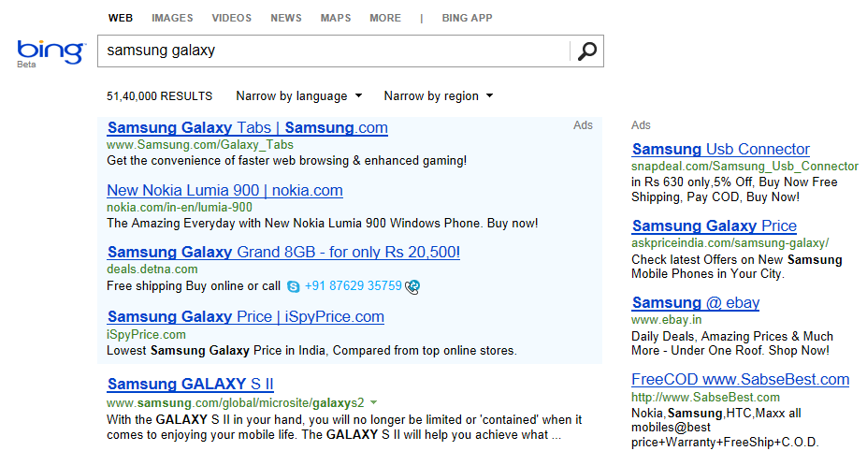





Generalized Second Pricing Model
Allocation and pricing in paid search are based on Generalized Second Price auction (GSP)
Both the ranking and the pricing of ads depend on the estimated probability of a user clicking on a given ad impression (eCTR)
(We approximate $′α$’ to be ~1 and also QBR~1000 )
**$Pricei1 =Bidi1∗\frac{Rankscorei2}{Rankscorei1}$
*$Rankscore =Bid∗(pClick)α∗\frac{1000}{QBR}$
$$Rankscore =Bid∗(pClick)$$
A1
$$Pricei1 =Bidi2∗\frac{pClicki2}{pClicki1}$$
A5
A2
BID | pClick (or eCTR) | Rank score* | Price (per click)**
$4.00 | 0.60 | 2.40 | $3.48
$3.80 | 0.55 | 2.09 | $2.86
$4.50 | 0.35 | 1.57 | $3.50
$3.50 | 0.35 | 1.22 | $2.85
A3
A1
Cost to be paid if a user clicks on the ad
A2
A4
A3
The Rank score used to calculate
will be higher of MLR or Rank score
of next advertiser(A5)
A4

Slide 13
Appendix

Slide 14
KPI Chart
RPS
SRPV
BSRPV
Impression
CPM
Imp Yield
BCTR
CPC
Revenue
Clicks
CPA
Conversion
Coverage
Ad Density
CTR
Conversion Rate
Click Yield

